Slide 1
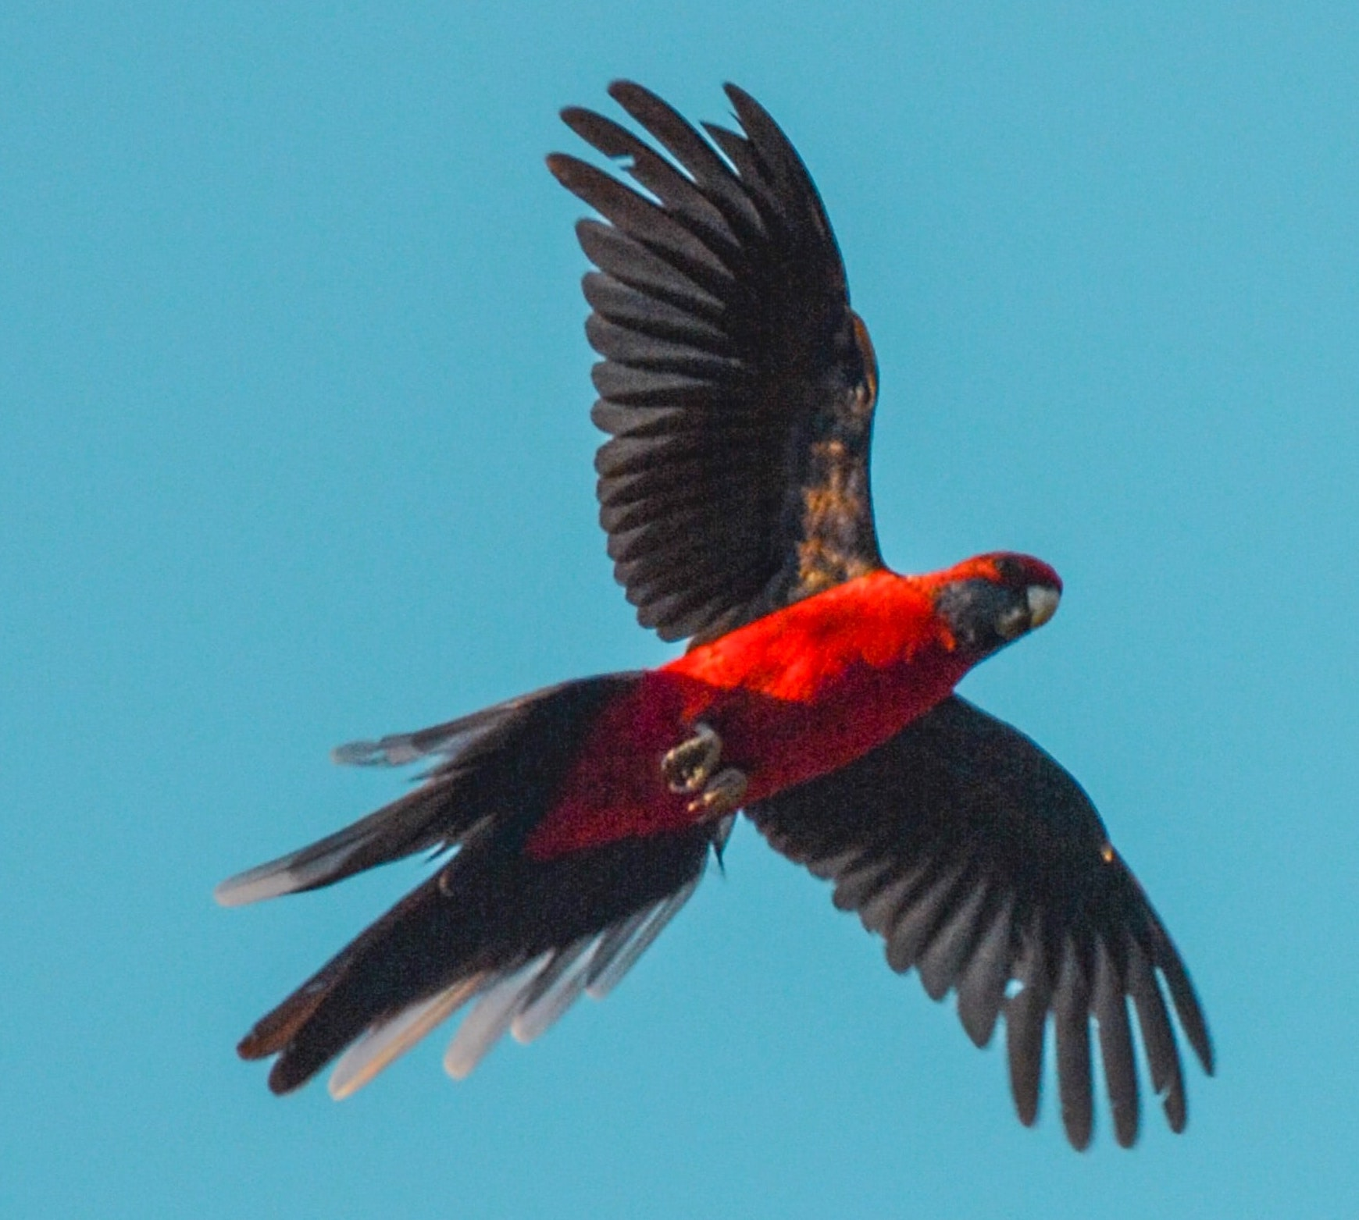


Taking Flight with MACAWS: Learning Corpora from and into the Classroom
May 18, 2020
Mariana Bertho marianabertho@email.arizona.edu
Aleksey Novikov alekseynovikov@email.arizona.edu
Adriana Picoral adrianaps@email.arizona.edu
Bruna Sommer-Farias brunasommer@email.arizona.edu
Shelley Staples slstaples@email.arizona.edu
Notes:
Introductions

Slide 2
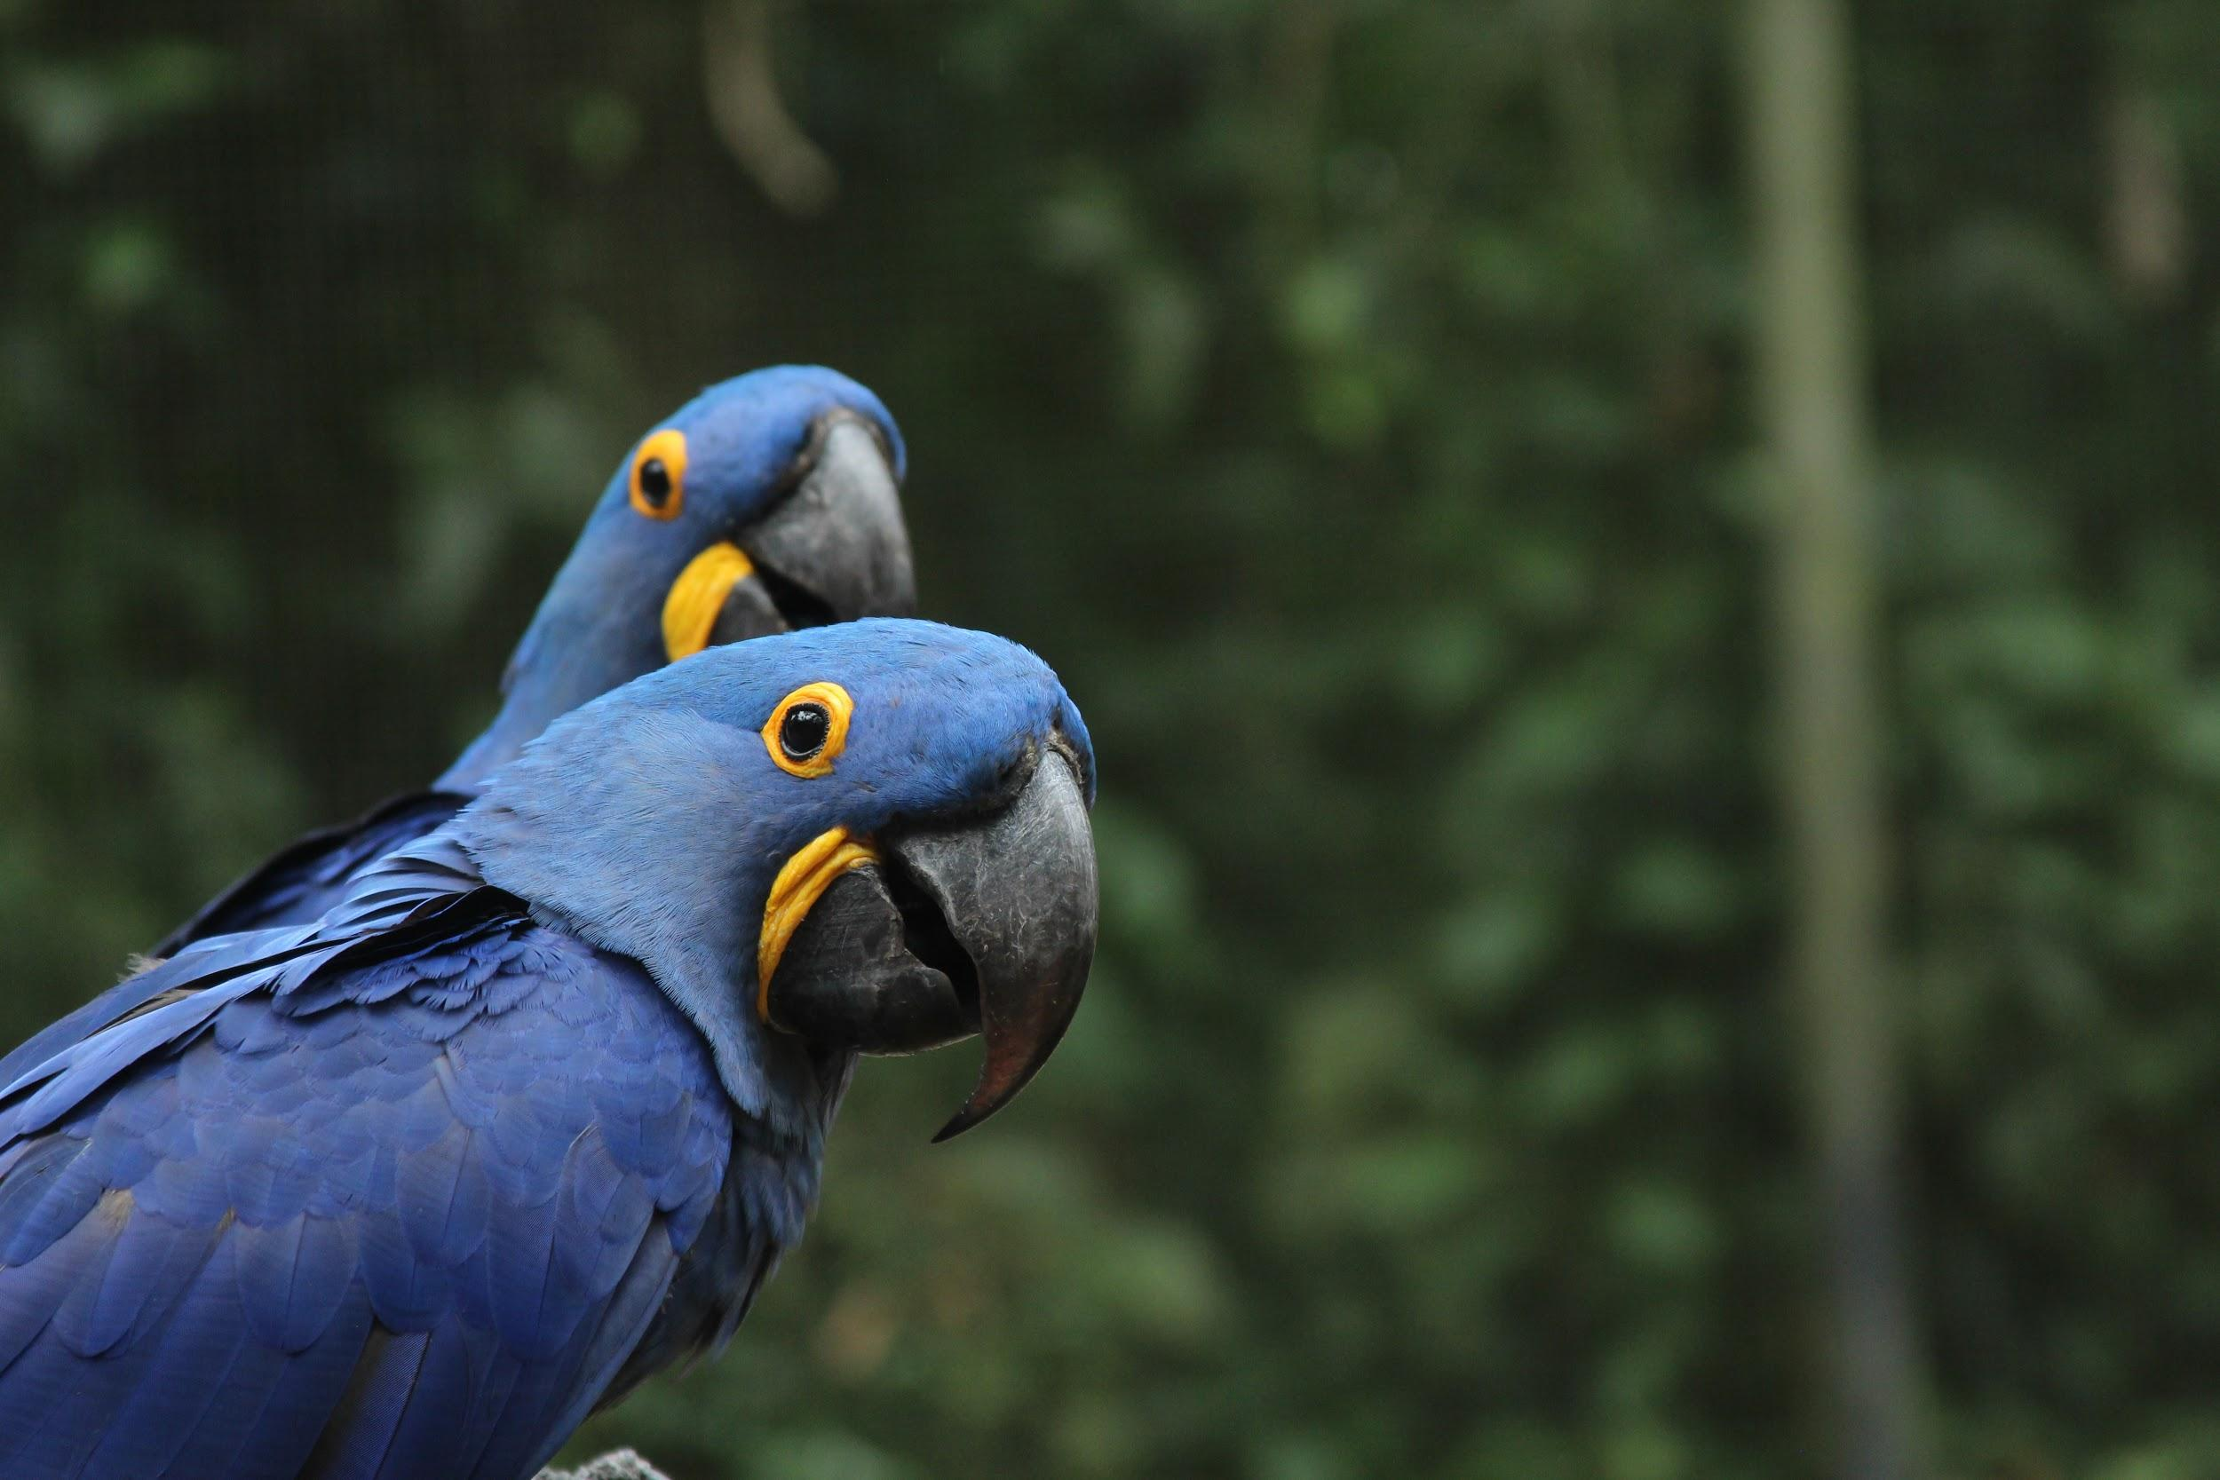
What is MACAWS?
Multilingual Academic Corpus of Assignments: Writing & Speech
Second Language (L2) | Number of files | Number of tokens | Number of students
Russian | 812 | 111,705 | 100
Portuguese | 3,000 | 536,168 | 255
Notes:
What is MACAWS?

Slide 3

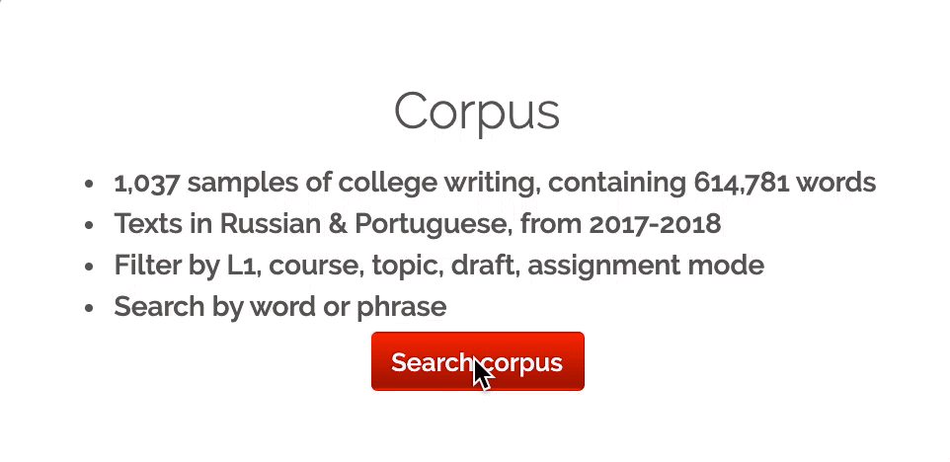
Accessing MACAWS
Go to https://macaws.corporaproject.org
username macawsarizona
password bsqtwg
Click on “Search corpus”

Slide 4
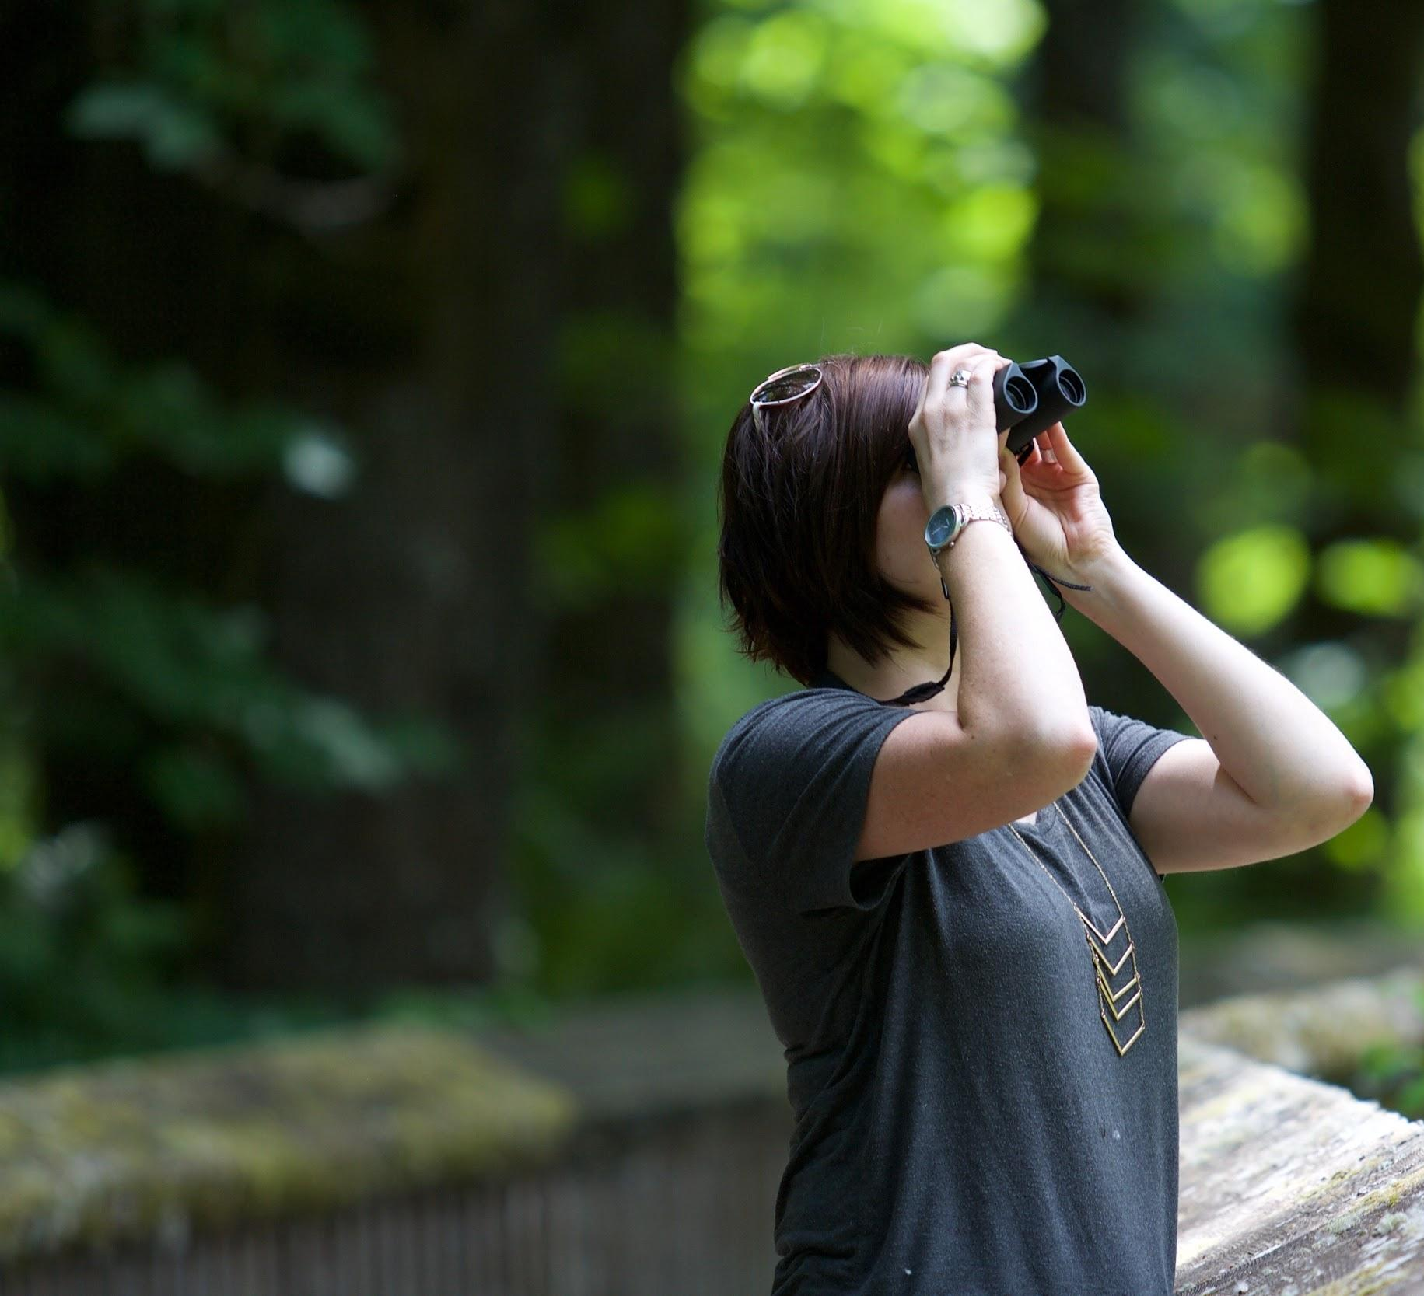
Searching and Filtering MACAWS

Slide 5
Search: acho acredito

Slide 7

Data-Driven Learning
Incorporation of authentic examples of language use into classroom activities
Main goal: Pattern noticing

Slide 8
iDDL example -- Portuguese
Todos todas

Slide 9
iDDL example -- Russian

Slide 10
iDDL -- how to search and embed

Slide 11

Your turn!
What other searches would you implement for your classroom?
What type of iDDL activity could you do with these search results?
Write your answers in the chat or click on the raise hand icon to share your ideas.

Slide 12

List of Resources
http://macaws.flock.group
http://crow.corporaproject.org
AntConc
  https://www.laurenceanthony.net/software/antconc
Iframe generator to embed Google Docs & others
  https://www.iframe-generator.com/
Fill in the blanks activity generator
  http://htmlpreview.github.io/?https://github.com/picoral/cloze_html_builder/blob/master/index.html
Scholarly articles
Boulton, A., & Cobb, T. (2017). Corpus use in language learning: A meta‐analysis. Language Learning, 67(2), 348-393.
Gilquin, G., & Granger, S. (2010). How can data-driven learning be used in language teaching? In A. O’Keefe & M. McCarthy (Eds.), The Routledge Handbook of Corpus Linguistics (pp. 359–370). London: Routledge.

Slide 13
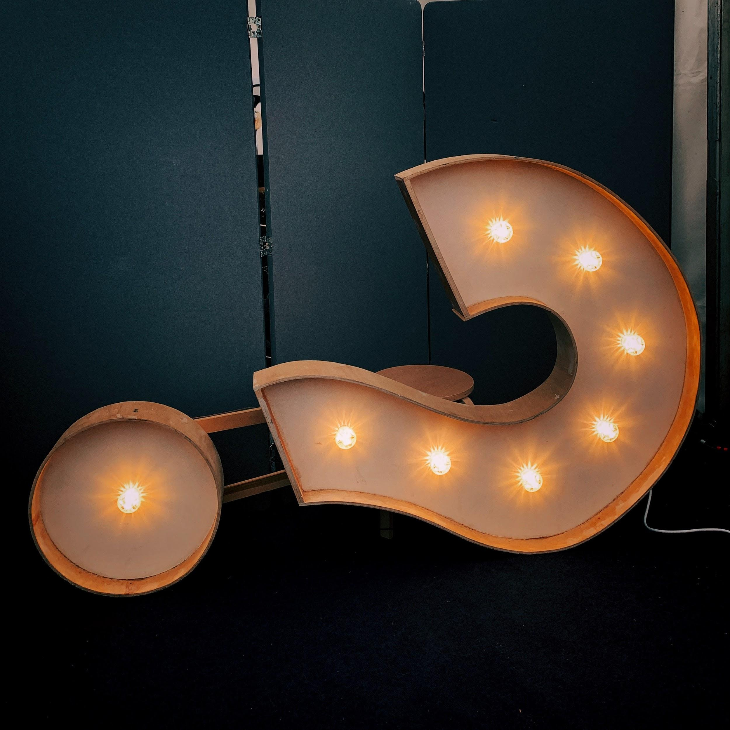

Thank you! Questions?
Mariana Bertho marianabertho@email.arizona.edu
Aleksey Novikov alekseynovikov@email.arizona.edu
Adriana Picoral adrianaps@email.arizona.edu
Bruna Sommer-Farias brunasommer@email.arizona.edu
Shelley Staples slstaples@email.arizona.edu
https://macaws.corporaproject.org/

